Slide 1
How the Page Object Model and Promises Work Together
Hal Deranek
Solution Principal, Slalom

Slide 2
AGENDA
What we’ll do today
Introduction
Explain the Page Object Model
Explain Promises
Show best practices when working with both
Write a test

Slide 3
INTRODUCTION
When will this be of help?
Test automation suites for asynchronous websites (Angular framework, React framework, etc.)
When could this be avoided?
You are already familiar with the Page Object Model and are working on non-asynchronous websites (HTML, Ruby-on-Rails, etc.)
What will be needed?
Basic understanding of Object-Oriented Programming
Basic understanding of test automation frameworks like Selenium-Webdriver and Jasmine
A note about examples
Typescript and Protractor will be used for examples; theory can be applied to other languages and frameworks
Before we begin…
Where should this be applied, when should it not, and what will you need to get started
SLALOM BUILD ALL RIGHTS RESERVED. PROPRIETARY AND CONFIDENTIAL.

Slide 4
Explaining the Page Object Model
Notes:
Ask audience "Does anyone have experience using the Page Object Model?" Then, "Who knows what a page object is?"

Slide 5
“
“A page object is an object-oriented class that serves as an interface to a page of your [application under test]. The tests then use the methods of this page object class whenever they need to interact with the UI of that page.”
Seleniumhq.org

Slide 6
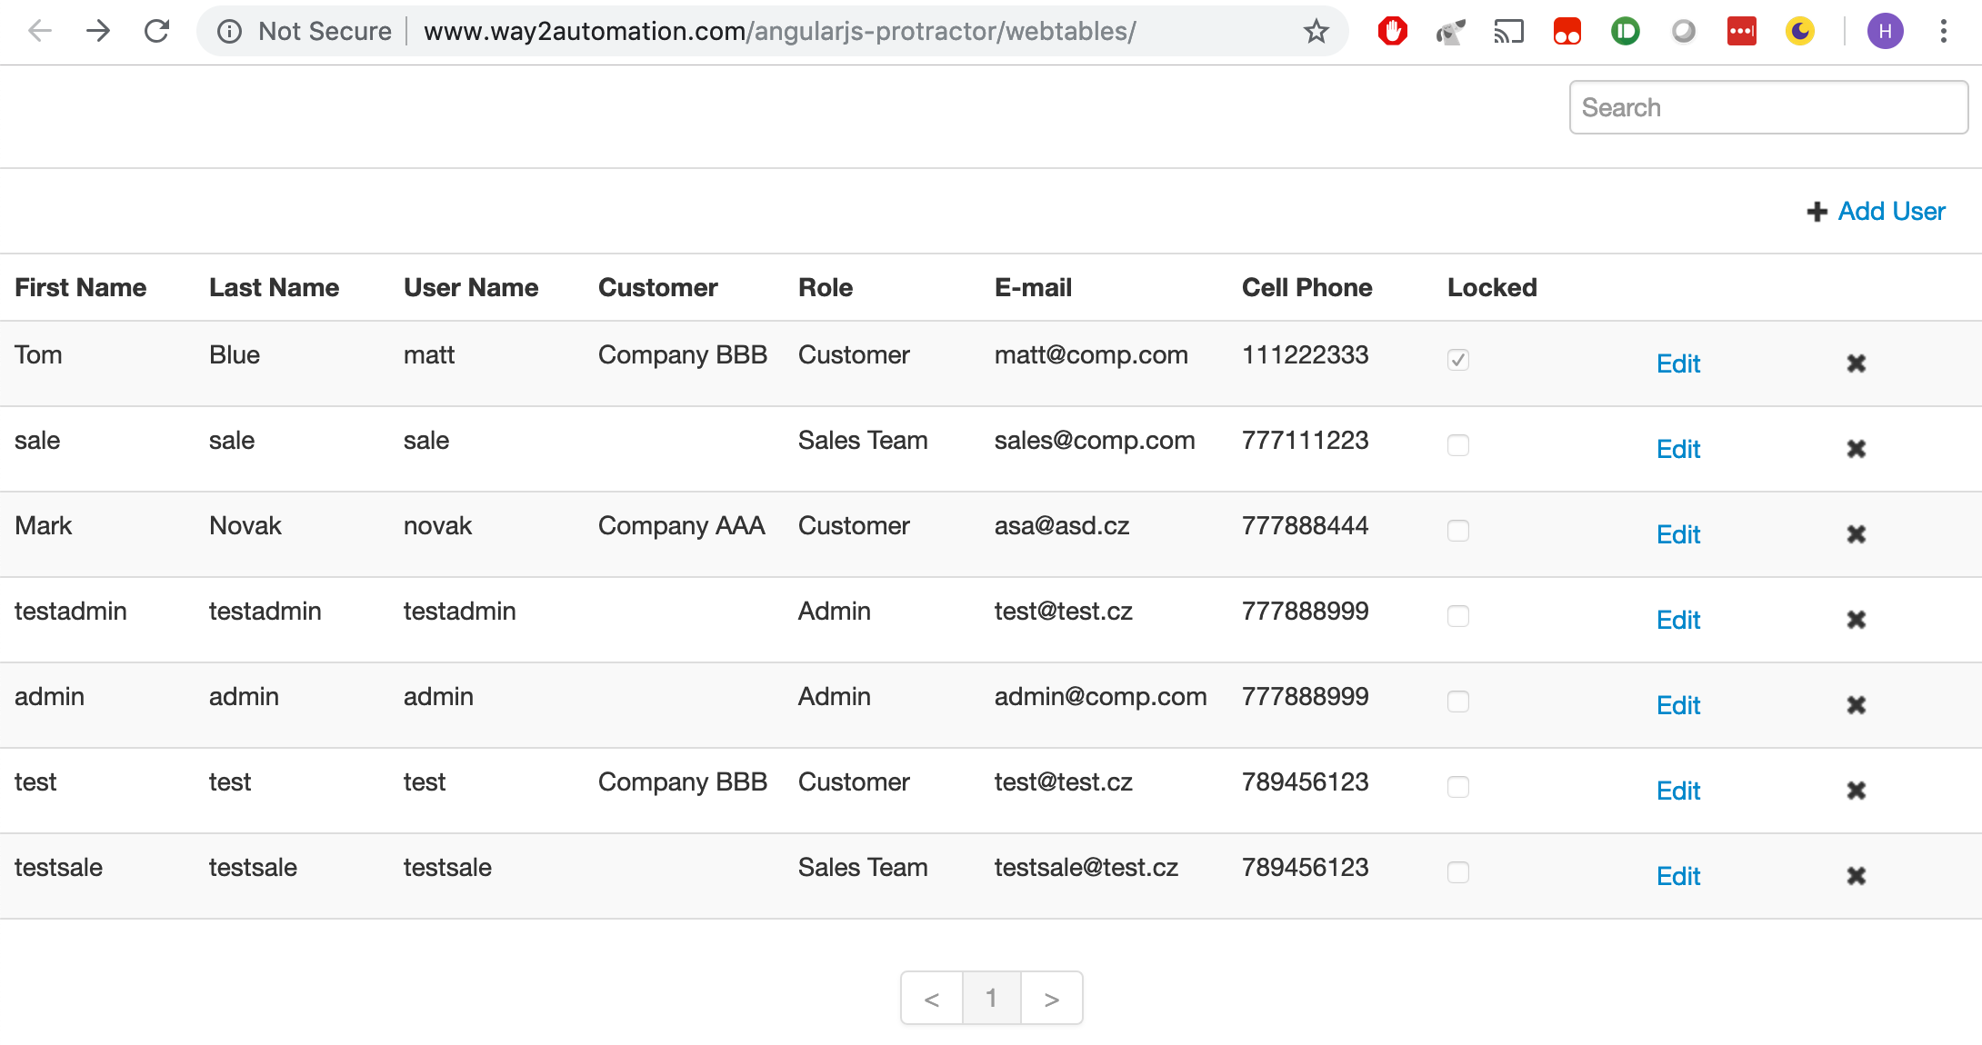
EXPLAINING THE PAGE OBJECT MODEL
Explaining the Page Object Model
Rules of the Page Object Model:
Every element seen is treated as an object
Create a class for all new sections and patterns
Keep code DRY and organized
Benefits of the Page Object Model:
Easier to implement
Easier to maintain
Easier to understand
SLALOM BUILD ALL RIGHTS RESERVED. PROPRIETARY AND CONFIDENTIAL.
Notes:
Explain DRY

Slide 7
EXPLAINING THE PAGE OBJECT MODEL
How many elements are on this page?
SLALOM BUILD ALL RIGHTS RESERVED. PROPRIETARY AND CONFIDENTIAL.

Slide 8
EXPLAINING THE PAGE OBJECT MODEL
How many elements are on this page?
1
2
3
4
5
6
7
8
9
10
11
12
13
14
15
16
17
18
19
20
21
22
23
24
25
26
27
28
29
30
31
32
33
34
35
36
37
38
39
40
41
42
43
44
45
46
47
48
49
50
51
52
53
54
55
56
57
58
59
60
61
62
63
64
65
66
67
68
69
70
71
72
73
74
75
76
77
78
79
80
81
82
83
84
SLALOM BUILD ALL RIGHTS RESERVED. PROPRIETARY AND CONFIDENTIAL.
Notes:
http://www.way2automation.com/angularjs-protractor/webtables/

Slide 9
EXPLAINING THE PAGE OBJECT MODEL
Exploit sections and patterns
SLALOM BUILD ALL RIGHTS RESERVED. PROPRIETARY AND CONFIDENTIAL.

Slide 10
EXPLAINING THE PAGE OBJECT MODEL
Implementing the code
export class DashboardPage {
constructor() {}
public get searchBar(): SearchBarSection {
return new SearchBarSection(element(by.css(‘td.global-search’)));
}
public get addUserButton(): AddUserSection {
return new AddUserSection(element(by.css(‘td.actions-add-url’)));
}
public get userTableTitles(): UserTableTitles {
return new UserTableTitles(element(by.css(‘tr.table-header-row’)));
}
public get userTableRecords(): UserTableRecords {
return new UserTableRecords(element(by.css(’tbody’)));
}
public get userTablePagination(): Pagination {
return new Pagination(element(by.css(’pagination’)));
}
}
export class SearchBarSection {
constructor(private container: ElementFinder) {}
public get inputBox(): ElementFinder {
return container.element(by.css(‘input’)));
}
}
export class UserTableRecord {
constructor(private container: ElementFinder) {}
public get firstName(): ElementFinder {
return container.element(by.css(‘td.firstName’)));
}
public get lastName(): ElementFinder {
return container.element(by.css(‘td.lastName’)));
}
public get userName(): ElementFinder {
return container.element(by.css(‘td.userName’)));
}
public get customer(): ElementFinder {
return container.element(by.css(‘td.customer’)));
}
public get role(): ElementFinder {
return container.element(by.css(‘td.role’)));
}
...
export class UserTableRecord {
constructor(private container: ElementFinder) {}
public get firstName(): ElementFinder {
return container.element(by.css(‘td.firstName’)));
}
public get middleName(): ElementFinder {
return container.element(by.css(‘td.middleName’)));
}
public get lastName(): ElementFinder {
return container.element(by.css(‘td.lastName’)));
}
public get userName(): ElementFinder {
return container.element(by.css(‘td.userName’)));
}
public get customer(): ElementFinder {
return container.element(by.css(‘td.customer’)));
}
...
export class UserTableRecords {
constructor(private container: ElementFinder) {}
public async getUserRecords(): Promise<UserTableRecord[]> {
const records: UserTableRecord[] = [];
for(const record of (await container.element.all(by.css(‘tr’)))) {
records.push(new UserTableRecord(record);
}
return records;
}
}
SLALOM BUILD ALL RIGHTS RESERVED. PROPRIETARY AND CONFIDENTIAL.
Notes:
* Talk about making it easier to maintain

Slide 11
EXPLAINING THE PAGE OBJECT MODEL
Code Example
Getting the first name of the third record
Get the Dashboard page
Get the User Table Records
Get the third record
Get the first name of that record
Execution code
const dashboard: DashboardPage = new DashboardPage();
const records: UserTableRecords = dashboard.userTableRecords;
const thirdRecord: UserTableRecord
= new UserTableRecord(await records.getuserRecords())[2];
const thirdRecordFirstName: ElementFinder = thirdRecord.firstName;
const dashboard: DashboardPage = new DashboardPage();
const records: UserTableRecords = dashboard.userTableRecords;
const thirdRecord: UserTableRecord
= new UserTableRecord(await records.getuserRecords())[2];
const dashboard: DashboardPage = new DashboardPage();
const dashboard: DashboardPage = new DashboardPage();
const records: UserTableRecords = dashboard.userTableRecords;
const dashboard: DashboardPage = new DashboardPage();
const thirdRecordFirstName: ElementFinder
= (await dashboard.userTableRecords.getuserRecords())[2].firstName;
Class code
export class DashboardPage {
constructor() {}
...
public get userTableRecords(): UserTableRecords {
return new UserTableRecords(element(by.css(’tbody’)));
}
...
}
export class UserTableRecord {
constructor(private container: ElementFinder) {}
...
public get firstName(): ElementFinder {
return container.element(by.css(‘td.firstName’)));
}
...
export class DashboardPage {
constructor() {}
...
public get userTableRecords(): UserTableRecords {
return new UserTableRecords(element(by.css(’tbody’)));
}
...
}
export class UserTableRecords {
constructor(private container: ElementFinder) {}
public async getUserRecords(): Promise<UserTableRecord[]> {
const records: UserTableRecord[] = [];
for(const record of (await container.element.all(by.css(‘tr’)))) {
records.push(new UserTableRecord(record);
}
return records;
}
}
Notes:
* Talk about making it easier to maintain

Slide 12
Explaining Promises
Notes:
Ask audience if anyone has experience working w/ promises. If so, what has their experience been.

Slide 13
EXPLAINING PROMISES
What are Promises?
“A Promise is an asynchronous operation. It’s called a “Promise” because we are promised a result at a future time.”
- https://toddmotto.com/promises-angular-q
Translation:
All website elements are requested at once (parallel instead of series)
Elements load as they become available rather than in a specific, linear order
Great for websites and usability
Difficult for testing
SLALOM BUILD ALL RIGHTS RESERVED. PROPRIETARY AND CONFIDENTIAL.

Slide 14
EXPLAINING PROMISES
Why are Promises difficult?
They don’t act like testers want (linear)
Your code
let newElement = element(by.css('div’));
console.log(`Is the element present? ${newElement.isPresent()}`);
What you expect
Is the element present? true
What you get
Is the element present? ManagedPromise::428 {[[PromiseStatus]]: ”pending”}

Slide 15
EXPLAINING PROMISES
Handling Promises
All element interactions return a Promise
Finding an element – element(by.css(‘td’)) – does not return a promise
Think of it as an address, pointer
Working with the element – getting text, clicking, sending text, etc. – returns a promise
Finding all elements by an address – element.all(by.css(‘td’)) – does return a promise
Use Async/Await
Keywords used to assist with asynchronous functionality
await forces framework to resolve a Promise before moving on
async casts a method to a Promise and enables the use of await
SLALOM BUILD ALL RIGHTS RESERVED. PROPRIETARY AND CONFIDENTIAL.

Slide 16
EXPLAINING PROMISES
Handling Promises - Example
Previous code
let newElement = element(by.css('div’));
console.log(`Is the element present? ${newElement.isPresent()}`);
New code
console.log(`Is the element present? ${await newElement.isPresent()}`);
What you get
Is the element present? true

Slide 17
EXPLAINING PROMISES
Final thoughts…
Location matters
await must be placed just before and with scope of the promise
console.log(`Is the element present? ${await newElement.isPresent()}`);
One await will not resolve all promises – chaining promises
await must be placed just before and within scope of the promise
let firstName: string;
firstName = await dashboard.userTableRecords.getUserRecords()[0].firstName.getText();
let firstName: string;
firstName = await (await dashboard.userTableRecords.getUserRecords())[0].firstName.getText();
SLALOM BUILD ALL RIGHTS RESERVED. PROPRIETARY AND CONFIDENTIAL.

Slide 18
Best Practices

Slide 19
BEST PRACTICES
Best ways to implement Page Object Model & Promises
NOT Constructors
Constructors cannot resolve Promises within scope
Using properties will require a refresh when the page is updated
export class UserTableRecords {
userRecords : UserRecord[];
constructor(private container: ElementFinder) {
for(const record of (await container.element.all(by.css(‘tr’)))) {
userRecords.push(new UserRecord(record);
}
}
}

Slide 20
BEST PRACTICES
Using the get syntax
export class UserTableRecord {
constructor(private container: ElementFinder) {}
public get firstName(): ElementFinder {
return container.element(by.css(‘td.firstName’)));
}
public get lastName(): ElementFinder {
return container.element(by.css(‘td.lastName’)));
}
public get userName(): ElementFinder {
return container.element(by.css(‘td.userName’)));
}
...
public async getFullName(): Promise<string> {
return `${await this.firstName.getText()} ${await this.lastName.getText()}`;
}
...

Slide 21
BEST PRACTICES
Returning a promise with the get syntax
export class UserTableRecords {
constructor(private container: ElementFinder) {}
public get userRecords(): Promise<UserRecord[]> {
const records: UserRecord[] = [];
return(async () => {
for(const record of (await container.element.all(by.css(‘tr’)))) {
records.push(new UserRecord(record);
}
return records;
})();
}
}

Slide 22
BEST PRACTICES
Using the get syntax
Pros
Avoids using the constructor and convoluted workarounds
Will always access the most recent data
Easy to implement, update
Cons
Somewhat costly – will have to get the element location each time a property/method is called
Can be difficult to read the code for languages that don’t support the get syntax at the property level (Typescrpt)

Slide 23
Writing a Test

Slide 24
BEST PRACTICES
Writing a test

Slide 25
BEST PRACTICES
Writing a test
describe(‘User records’, () => {
let dashboard: DashboardPage;
let userRecords: UserTableRecord[];
const expectedName: string = ‘Mark’;
it(`should use “${expectedName}” for the first name of the third record`, () => {
dashboard = new DashboardPage();
userRecords = await dashboard.userTableRecords.getUserRecords();
const recordName: string = await userRecords[2].firstName.getText();
expect(recordName).toEqual(expectedName,
`First name of the third record should be ‘${expectedName}’ - is ‘${recordName}’`);
}
}

Slide 26
Q & A
Hal Deranek
deranek@gmail.com
SLALOM BUILD ALL RIGHTS RESERVED. PROPRIETARY AND CONFIDENTIAL.

